Slide 1
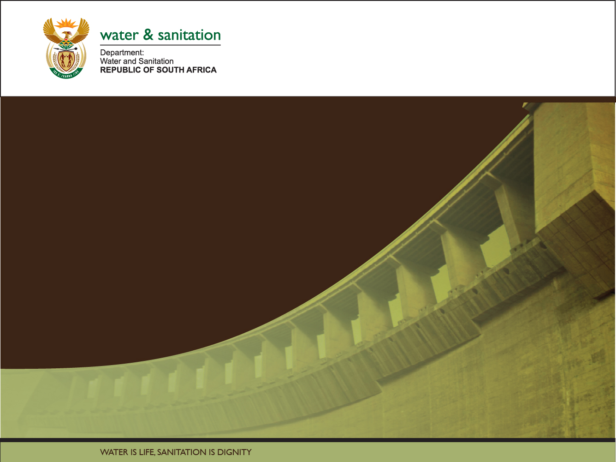

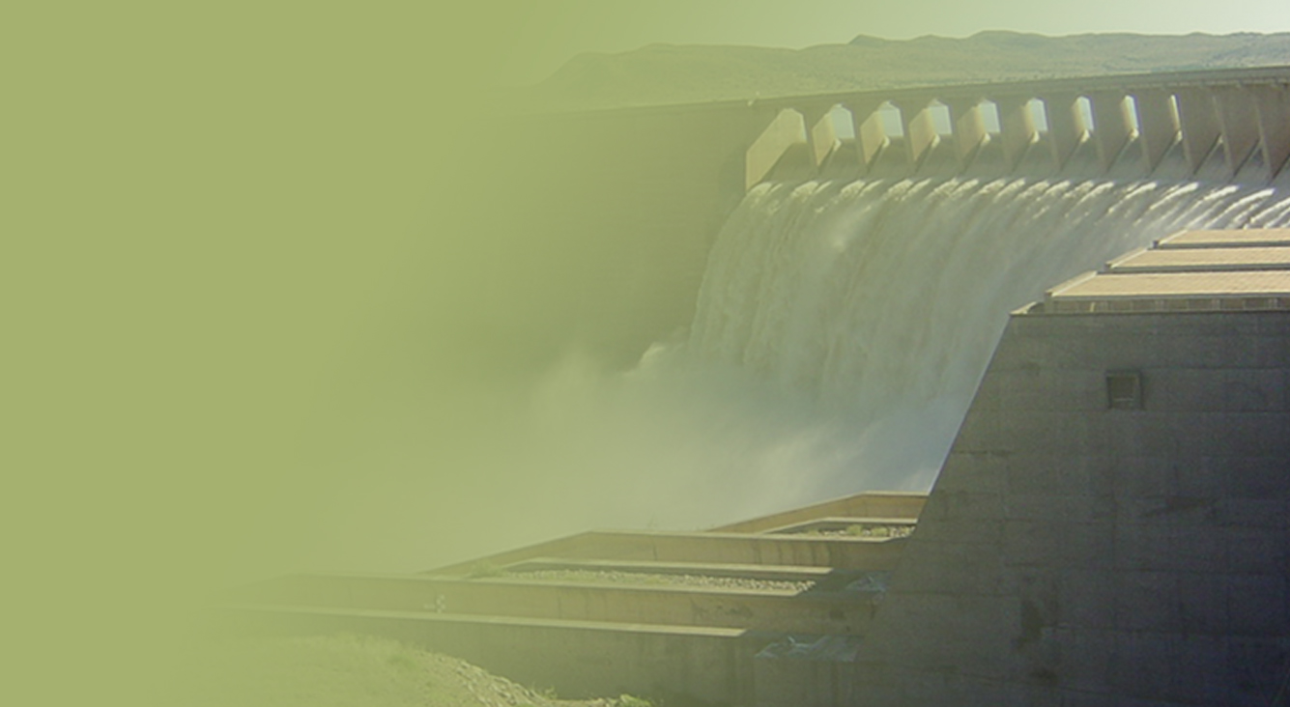
The Determination of Water Resources Classes and Resource Quality Objectives in the Breede-Gouritz WMA
TTG 2
Presented by: Louise Lodenkemper
Date: 13 March 2018
Venue: Robertson

Slide 2
Overview
Prioritised wetland per IUA
  Ecological Importance
  Provision of Ecosystem Services supply/demand (INR, 2017)
Component/Sub-component
  i.e. Quantity/Flow
Indicator
  Representation of trend tracking the measurable change in a system over time. Focuses on a small manageable set of information to get a sense of the “bigger picture”
RQO
  Descriptive broad statements describing overall objectives for the Resource Unit
Numerical limit
  Quantitative descriptors of different components of the Resource Unit

Slide 3
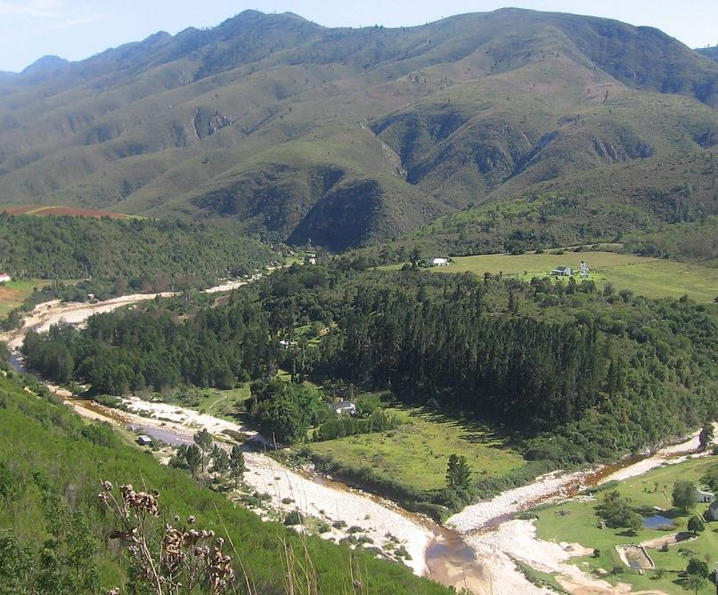

Methodology for Determination of RQOs
Priority wetlands in the Breede-Overberg
Notes:
Erik and team to present the methodology used for scenario evaluation

Slide 4
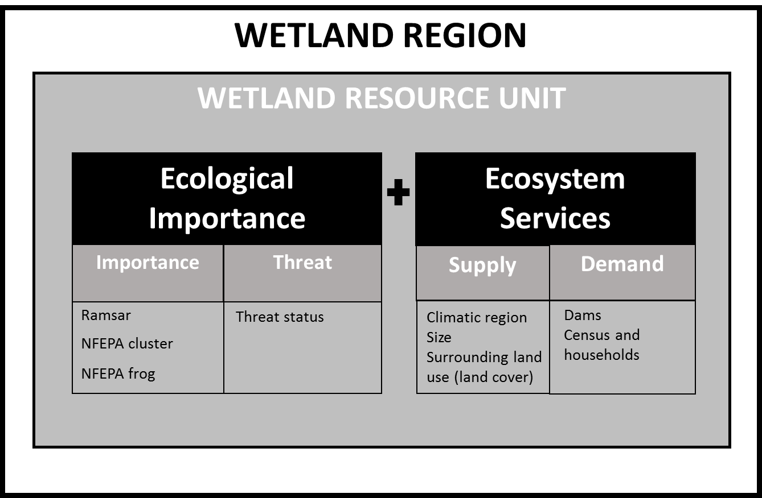
Identification of Priority Wetlands
Important wetlands include those that have ecological importance for maintenance of biodiversity ecosystem integrity, as well as those that provide ecosystem services.
z
Notes:
The Status Quo report defined the Wetland Regions within the study area according to the spatial framework of Ecoregions. Nested within Wetland Regions are the Wetland Resource Units, defined by vegetation type and Hydrogeomorphic (HGM) unit and prioritised according to Ecological Importance and Ecosystem Services. As the HGM unit is defined by landform it is important to understand the location of a wetland in the landscape and the underlying geological controls.
From an RDM perspective, important wetlands include those that have both ecological importance for the maintenance of biodiversity ecosystem integrity, as well as those that provide ecosystem services. In terms of ecosystem services, wetland prioritisation needs to consider both the ability of a wetland to provide services as well as the demand for such services within the catchment. These two aspects define the importance of wetlands in terms of ecosystem services.

Slide 5
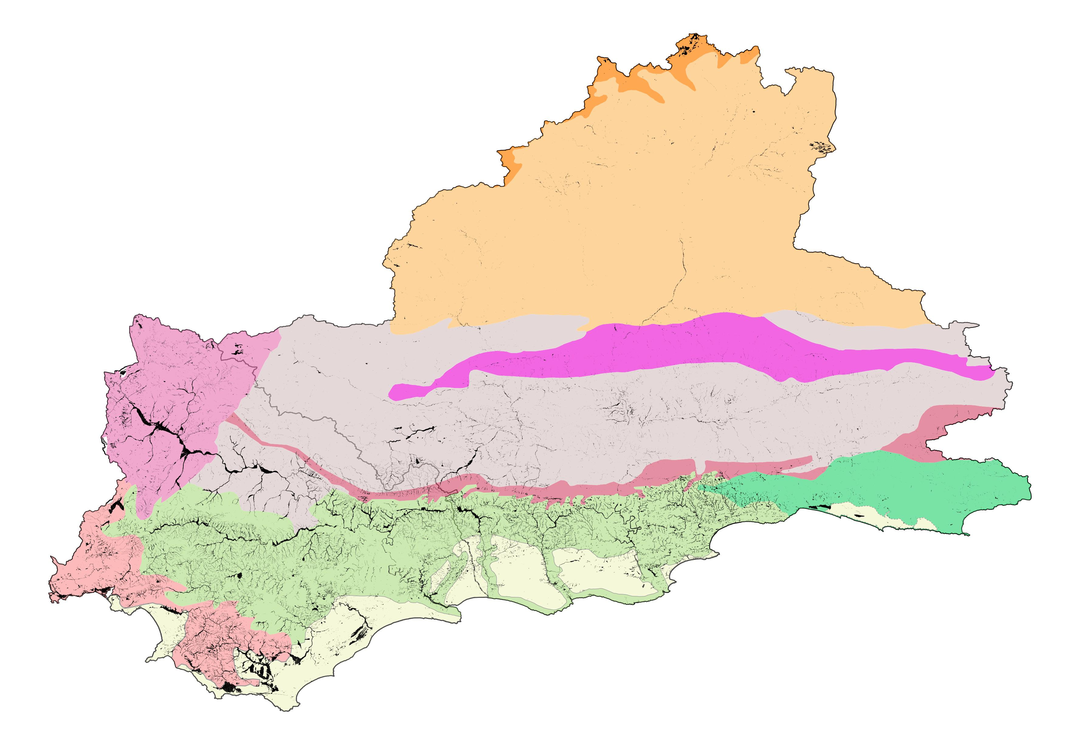
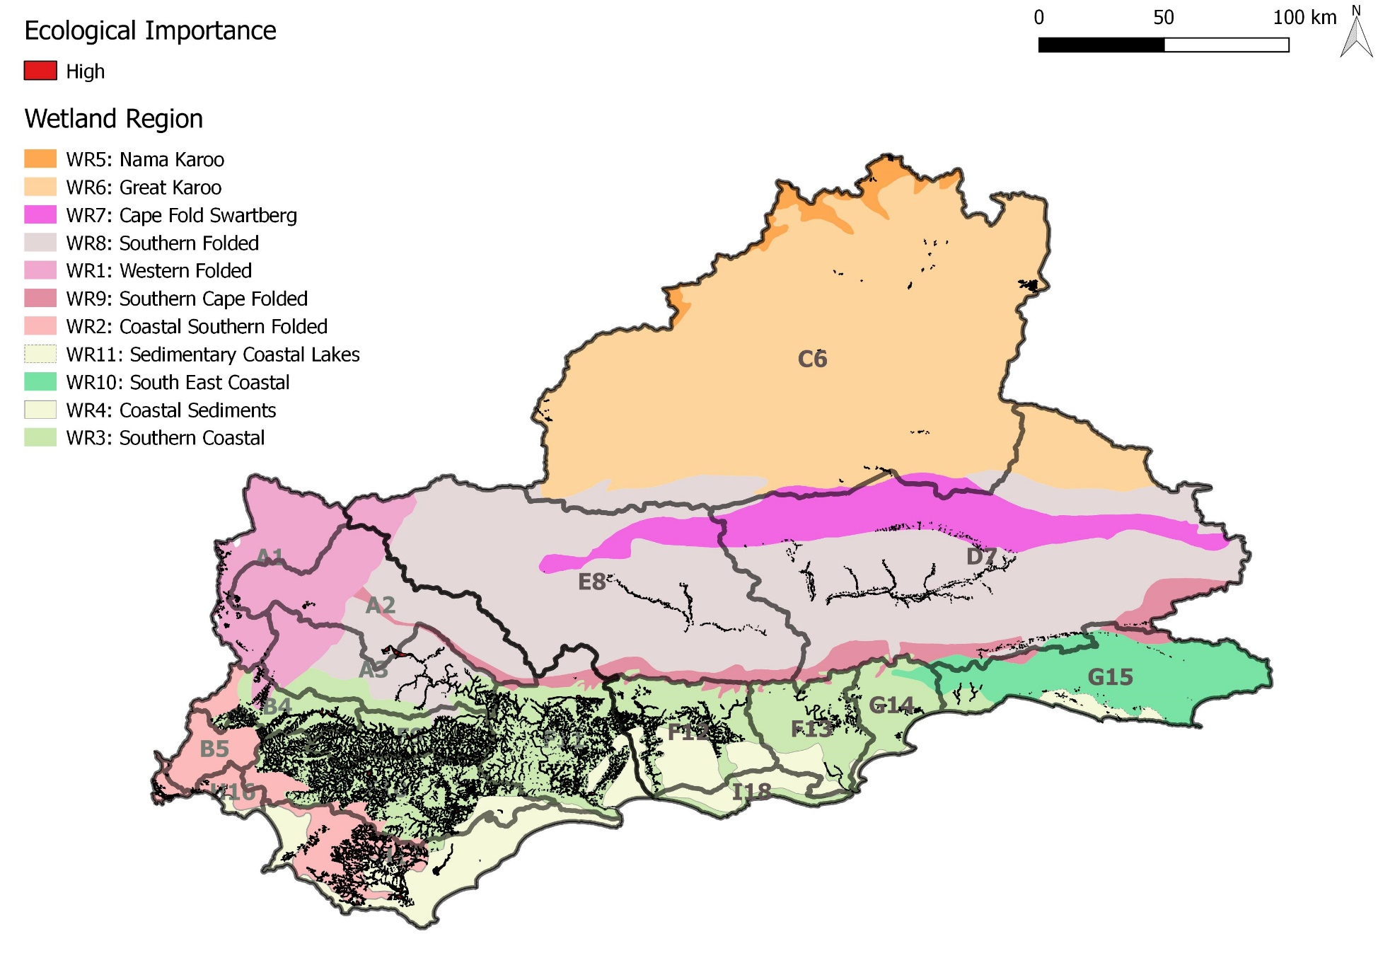
Study area has many wetlands
Many, many wetlands

Slide 6
Wetland Regions have typical wetland types
  Typically small seeps and river-linked wetlands
  Typically seeps with a likely high degree of groundwater dependence
  Typically small seeps and river-linked wetlands with a likely high degree of direct and indirect groundwater dependence
Typically small seeps associated with groundwater-fed springs
  Typically seeps and depressions as well as river-linked wetlands
  Typically valley bottom and floodplain wetlands
  Typically valley-bottom wetlands and seepage wetlands
  Typically lakes and wetland flats
  Typically seeps and depression wetlands as well as valley bottom and floodplain wetlands
  Typically valley bottom wetlands
Wetlands are infrequent, possibly due to deep infiltrating soils and a lack of shallow/perched water tables. Inter-dune depressional wetlands and present suggesting groundwater contributions

Slide 7
Ecologically Important Wetlands
 |  | Threat
 |  | High | Low
Ecological Importance | High | Implement restoration and rehabilitation to conserve ecologically important areas that are under threat. | Retain low current threat and possible future threat in ecological important areas.
 | Low | Areas of least concern | Areas of least concern
Different high scores for different Wetland Regions
 | Importance |  |  | Threat
Wetland Region | NFEPA cluster | NFEPA frogs | Ramsar | Critically endangered | Endangered | Vulnerable | Least Threatened | Score
Western Folded Wetland Region (WR1) | x |  |  |  | x |  |  | 1.05
 |  |  |  | x |  |  |  | 1.0
 | x |  |  |  |  | x |  | 0.6
Coastal Southern Folded Wetland Region (WR2) | x | x |  | x |  |  |  | 1.5
 | x | /x |  |  | x |  |  | 1.3
 | x | x |  | x |  |  |  | 1.25
Nama Karoo Wetland Region (WR5) | x |  |  |  |  |  | x | 0.25
Great Karoo Wetland Region (WR6) | x |  |  |  |  |  | x | 0.25

Slide 9
Provision of Ecosystem Services
 |  | Supply
 |  | High | Low
Demand | High | Retain to meet current demand. Implement management action to limit impact of heavy demand and ensure continued supply. | Implement restoration and rehabilitation to help meet current demand.
 | Low | Retain to meet low current and possible future demand. | Areas of least concern
Ecosystem services:
Regulating and supporting benefits | Flood attenuation |  | The spreading out and slowing down of floodwater in the wetland, thereby reducing the severity of floods downstream
 | Streamflow regulation |  | Sustaining streamflow during low flow periods
 | Water quality enhancement benefits | Sediment trapping | The trapping and retention in the wetland of sediment carried by runoff waters
 |  | Phosphate assimilation | Removal by the wetland of phosphates carried by runoff water
 |  | Nitrate assimilation | Removal by the wetland of nitrates carried by runoff water
 |  | Toxicant assimilation | Removal by the wetland of toxicants (e.g. metals, biocides and salts) carried by runoff water
 |  | Erosion control | Controlling of erosion at the wetland site, principally through the protection provided by vegetation
 | Carbon storage |  | The trapping of carbon by the wetland, principally as soil organic matter

Slide 10
Provision of Ecosystem Services
Identifying supply and demand for ecosystem services broadly identifies “hotspots” for regulating and supporting services provided by wetlands across the study area.
This was applied separately for the Breede-Overberg and Gouritz-Coastal regions to allow for representation.
The location and extent of different land cover types may also affect the capability of a wetland to supply ecosystem services. Some land cover types, such as commercial annual crops, may occur within a wetland and considerably diminish the ecological condition of the wetland and its ability to supply certain ecosystem services (Kotze, 2016). Other land cover types may occur in the upslope catchment of a wetland with less direct impacts.

Slide 11
Ecosystem services related to landcover:
Ecosystem service |  | Land-cover type
 |  | Natural | Dams | Crops | Alien trees¹ | Mining | Eroded | Urban infrastructure
1 | Sediment trapping & Erosion control | 1.0 | 0.8 | 0.3 | 0.8 | 0.4 | 0.2 | 0.7
2 | Phosphate, nitrate and toxicant assimilation | 1.0 | 0.8 | 0.1 | 0.6 | 0.2 | 0.2 | 0.1
3 | Flood attenuation | 1.0 | 0.8 | 0.4 | 1.1 | 0.3 | 0.4 | 0
4 | Streamflow regulation | 1.0 | 0.6 | 0.5 | 0.5 | 0.2 | 0.5 | 0
5 | Carbon storage | 1.0 | 0.6 | 0.2 | 0.6 | 0 | 0.2 | 0.2
6 | Provision of water | 1.0 | 1.1 | 0.2 | 0.2 | 0 | 0.4 | 0
7 | Harvestable resources | 1.0 | 0.5 | 0.2 | 0.3 | 0 | 0.3 | 0
8 | Cultivated foods | 0 | 0 | 1.0 | 0 | 0 | 0 | 0
Sed trapping NB
Streamflow reg NB
Provision of water NB
Maintained services
Reduced services, but still maintains sediment trapping, carbon storage & WQ amelioration
Cultivated goods NB
INR, 2017
Flood attenuation NB

Slide 12
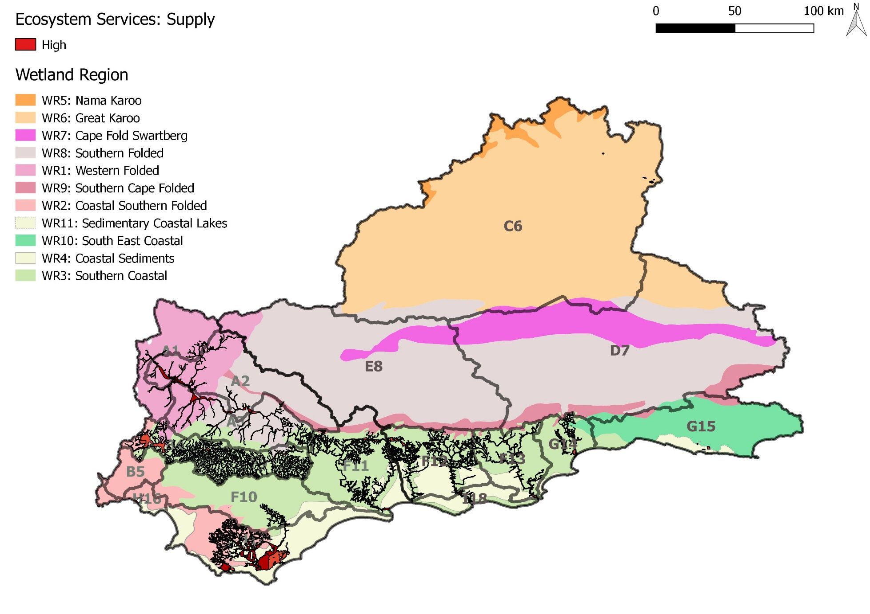

Slide 13
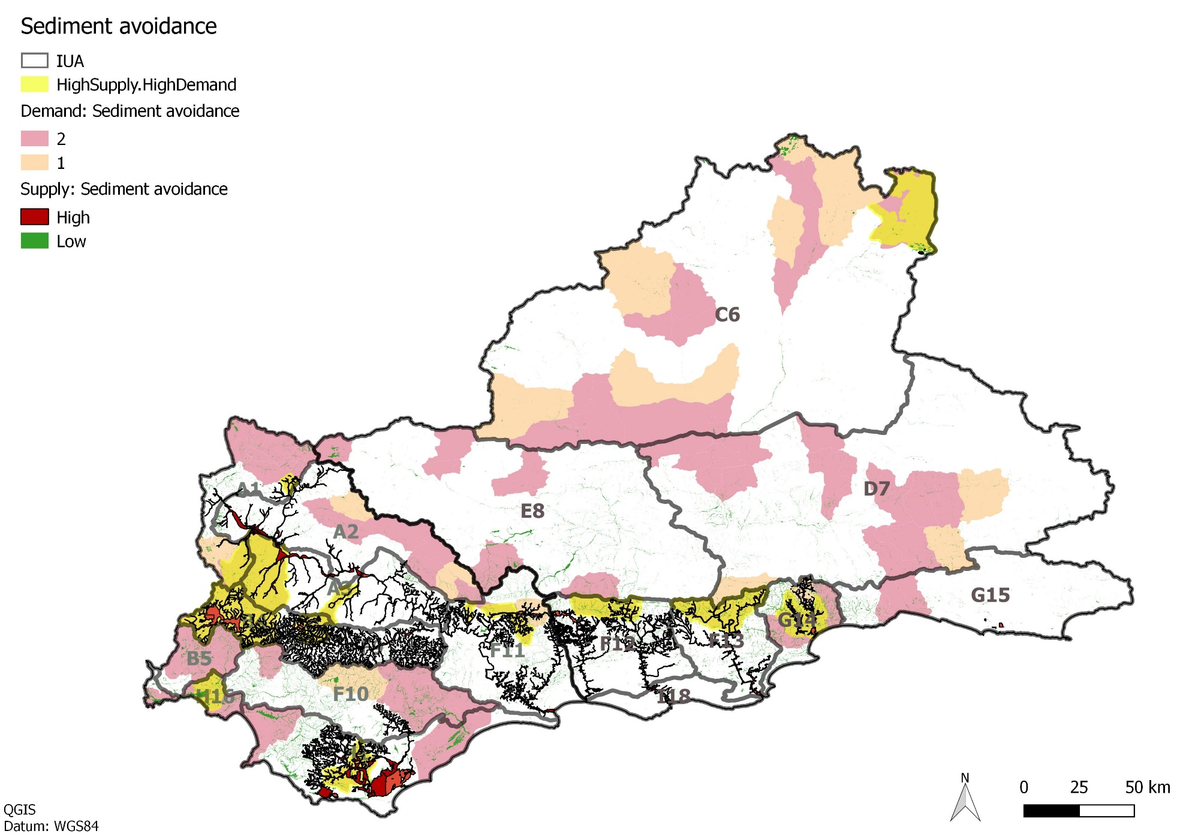
Wetland with high supply & demand for Sediment Avoidance

Slide 14
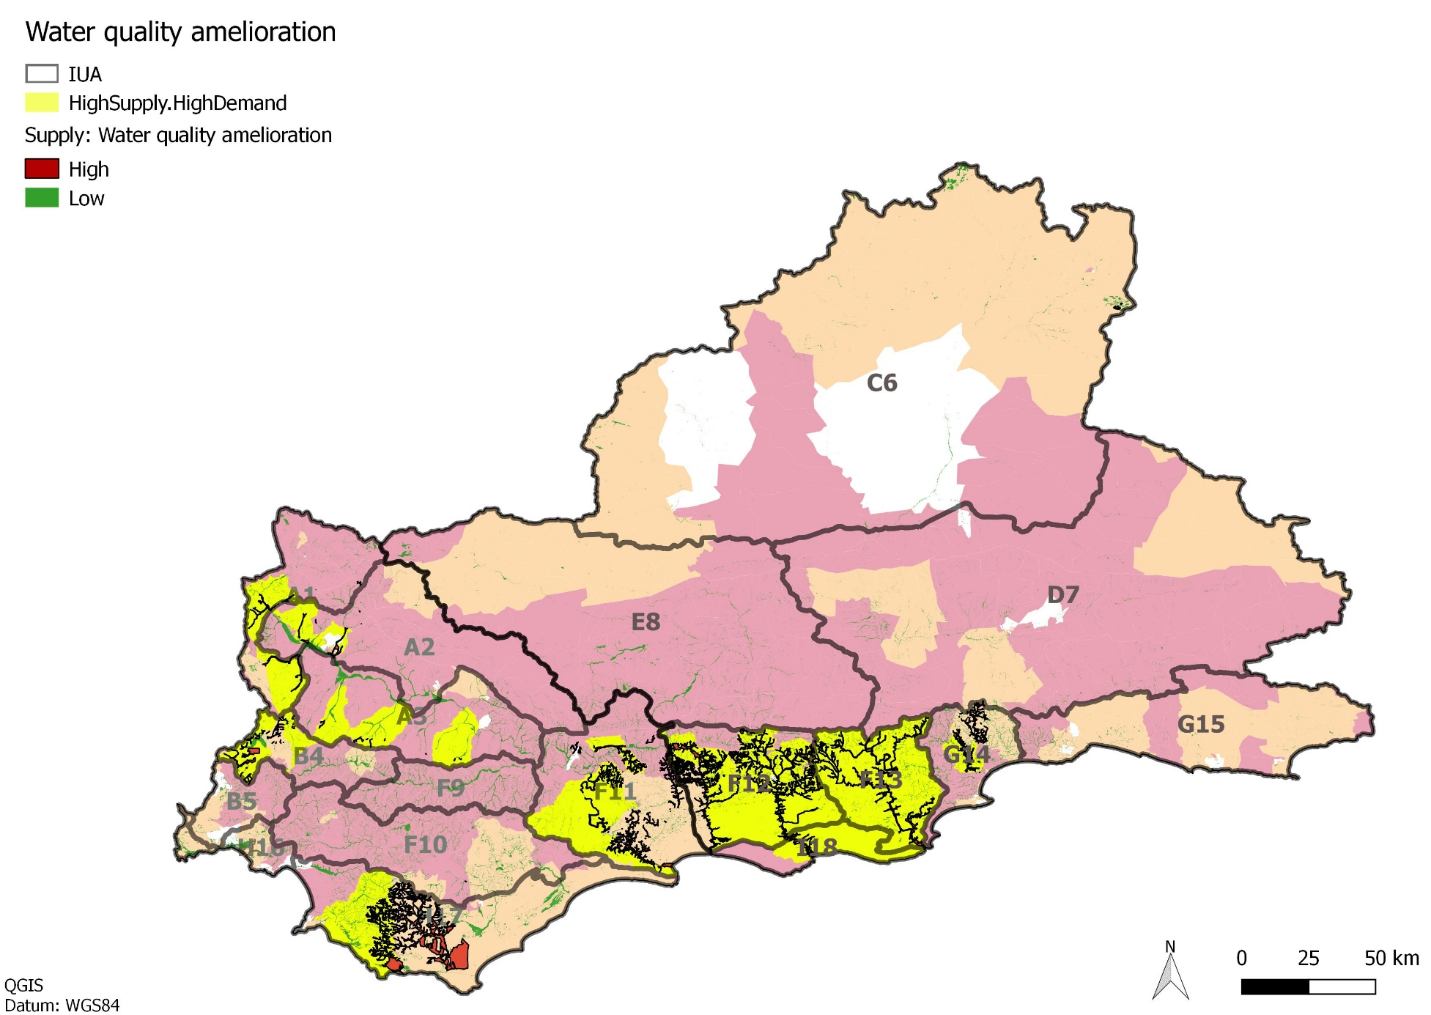
Wetland with high supply & demand for WQ amelioration

Slide 15
Integration of Importance & Supply/demand of Services
 |  | Demand.Supply
 |  | High.High | High.Low | Low.High | Low.Low
Ecological Importance. Threat | High.High
 | High.Low
 | Low.High
 | Low.Low

Slide 16
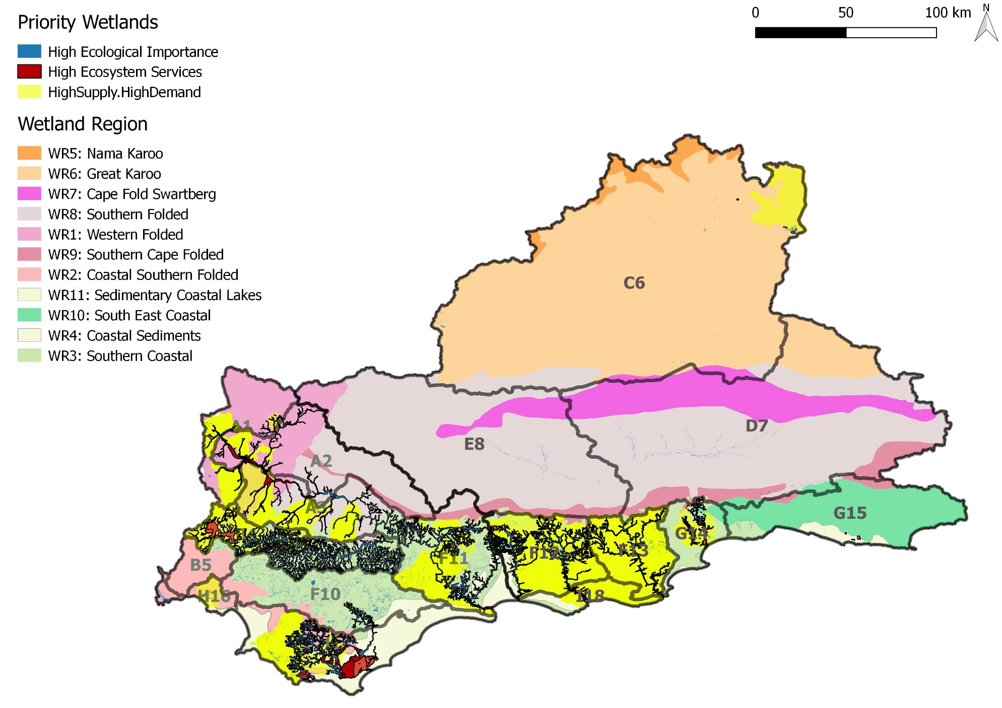

Slide 17
Methodology for Determination of RQOs
WETLANDS: RQO outline for wetland in the Breede-Overberg
Notes:
Erik and team to present the methodology used for scenario evaluation

Slide 18
Overview
Water Resource Class
Ecological importance & threat
Prioritisation
EcoSpecs & UserSpecs
RQO Indicators & Numerical Limits
Quantity
Quality
Habitat
Biota
Provision of Ecosystem Services
supply & demand
Available Info
Reserve info
Non-Reserve info

Slide 19
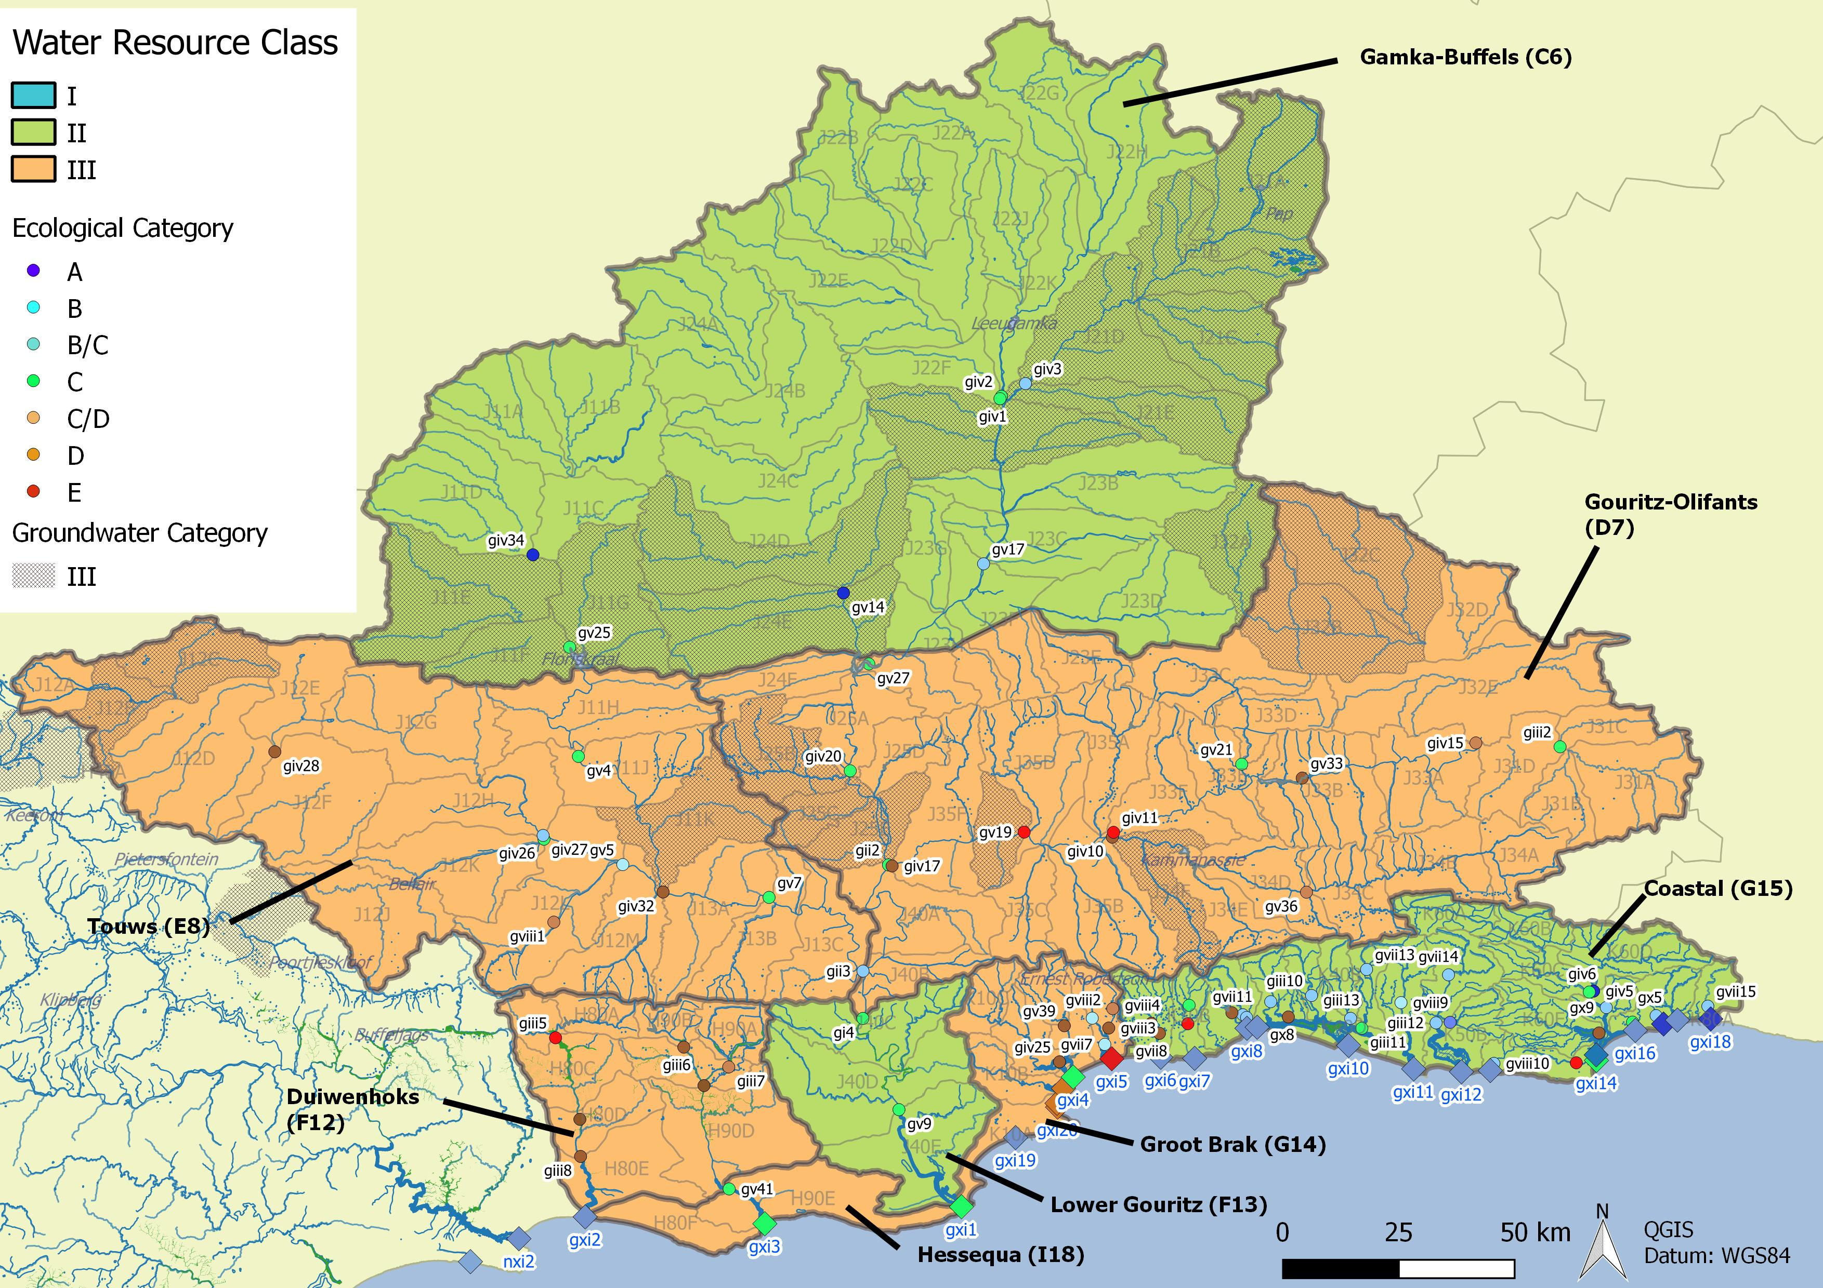
Overview: Water Resource Classification
Integrated Units of Analysis and Nodes

Slide 20
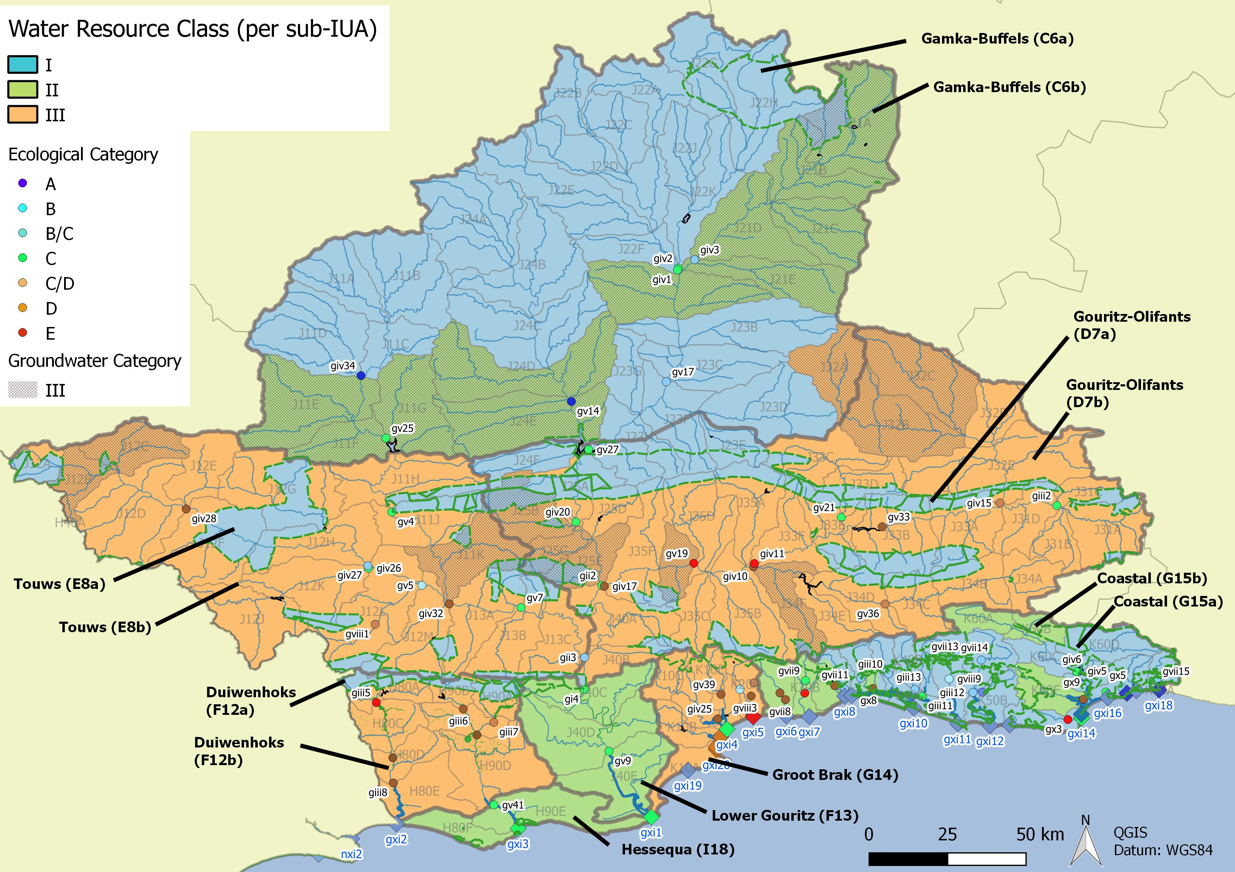
Overview: Management considerations

Slide 21
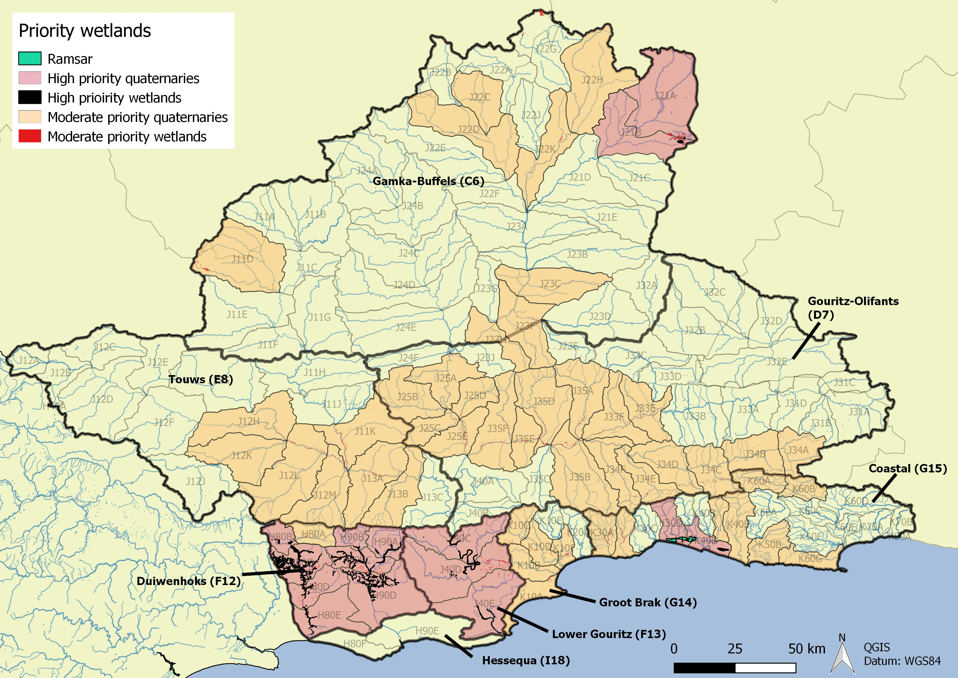
High and Moderate priority wetlands

Slide 22
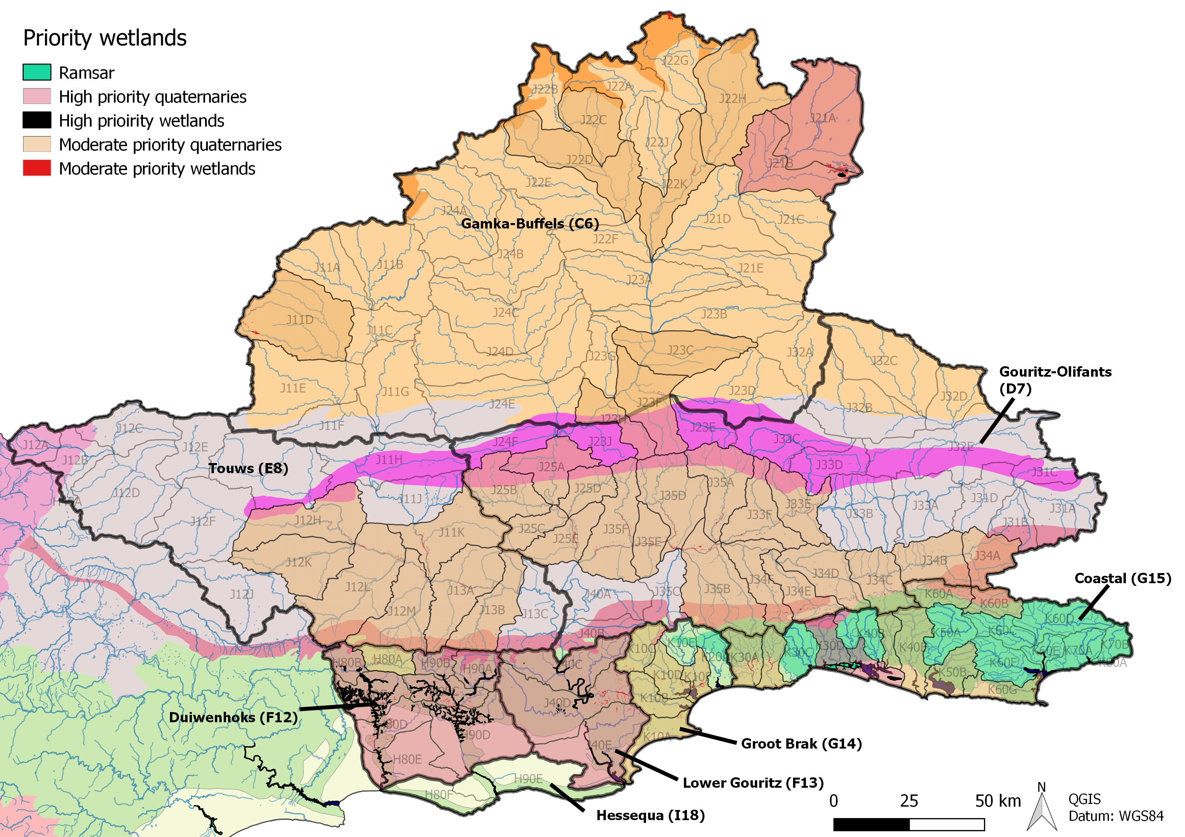
Wetland Regional Representation
Typically small seeps and river-linked wetlands
Seeps/groundwater dependent wetlands
small seeps
Typically small seeps & river-linked wetlands
Seeps & depressions
Valley bottom wetlands
Valley-bottom & Seeps
Wetlands are infrequent
Lakes & wetland flats

Slide 23
Components/Sub-components
Biota: Frogs/Birds
Habitat: Veg/Geomorphology
Quality: WQ & Sediment
Quantity:
Flow/Water retention & distribution
Components link to Wetland Health Assessment (Macfarlane et al. 2008), which needs to be emphasised due to the need to develop a baseline

Slide 24
Wetland types & RQOs
Quantity
Flow
Water retention & distribution
Type | High flows | Baseflow | Surrounding runoff
Floodplain | x | x | x
Channelled Valley-Bottom |  | x | x
Unchannelled Valley-Bottom |  | x | x
Seep |  | x | x
Depression |  | x | x
Flat |  | x | x
Maintain high flow events
Maintain water levels

Slide 25
Wetland types & RQOs
Quantity: Flow/Water retention & distribution
DWAF, 2009

Slide 26
Typical threats to Priority Wetlands: FLOODPLAINS
Movement of flood longitudinally
Deposition of sediment
High flow event
Ollis et al. 2013
  Generally receive most water during high flow events when waters overtop the streambank.
  NB flood attenuation because of the nature of vegetation and topographic setting. Flood attenuation is likely to be high early in the season until the floodplain soils are saturated, whilst in the late season flood attenuation is reduced.
  As flood waters overtop streambanks the waters drop sediments, and nutrient bound sediments, which are left behind to accumulate.
  The nature of clayey soils in floodplains means that soils retain water, thus limiting contribution to streamflow and groundwater recharge.
Limited infiltration/groundwater inflow (Baseflow)

Slide 27
Typical threats to Priority Wetlands: FLOODPLAINS
Movement of flood longitudinally
High flow event
Ollis et al. 2013
  Consumptive usage impacts will be reduction of high flow events, which will reduce saturation of vegetation (i.e. Dams/abstraction)
  Channel straightening and infilling through wetland “reclamation” also reduce functioning.
  Floodplain wetlands are generally resilient to changes in sediment inputs as the system is dominated by fluvial processes.
  Main impact of erosion is changing the natural dynamic.
Limited infiltration/groundwater inflow (baseflow)

Slide 28
Typical threats to Priority Wetlands: VALLEY-BOTTOM (Channelled)
Hillslope runoff
Narrower
Steeper
Ollis et al. 2013
Less active deposition than floodplains and tend to be narrower with steeper gradients.
Groundwater input to the main stem channel is also generally greater.
Consumptive usage impacts related to changes to baseflow which will reduce saturation of vegetation.
Channel straightening and infilling are the greatest impacts.
Changes in runoff characteristics and erosion/depositional features also important.
Greater infiltration/groundwater inflow (baseflow)

Slide 29
Typical threats to Priority Wetlands: VALLEY-BOTTOM (Unchannelled)
Diffuse unidirectional flow
Hillslope runoff
Ollis et al. 2013
Stream channel inputs are spread diffusely across the wetland even at low flows, resulting in high levels of soil organic matter.
This aids nitrate and toxicant removal, particularly if there is groundwater contribution.
Consumptive usage impacts related to changes to baseflow which will reduce saturation of vegetation.
Changes in runoff characteristics (increased stormwater inputs) and erosion/depositional features are threats.
Greater infiltration/groundwater inflow (baseflow)

Slide 30
Typical threats to Priority Wetlands: SEEPS
Diffuse unidirectional flow downslope
Hillslope runoff
Ollis et al. 2013
Normally associated with groundwater discharge, although there are additional contributions from surrounding runoff.
Contribute streamflow regulation early in the season, until soils are saturated.
Good provision of nitrate removal, but poor at erosion control owing to location on steep slopes.
The location on slopes means that hillslope seeps are sensitive to erosion.
Habitat transformation through agricultural use is also likely.
Mainly groundwater discharge (baseflow)

Slide 31
Typical threats to Priority Wetlands: DEPRESSIONS
Hillslope runoff
Diffuse flow/
accumulation
Channelled outflow/inflow
Ollis et al. 2013
Can receive both surface and groundwater flows, which accumulate in the depression.
Depression wetlands are sensitive to increased stormwater inputs as this impacts the seasonality of the wetlands.
Habitat transformation is also likely.
Infiltration/groundwater inflow (baseflow)

Slide 32
Typical threats to Priority Wetlands: FLATS
Diffuse, multidirectional flow
Ollis et al. 2013
Not fed by water from a river channel, and is typically situated on flat land (often on a coastal plain).
The primary source of water is precipitation, although on coastal plains groundwater may rise to or near the ground surface.
Water typically exits via evapotranspiration and infiltration.
Depression wetlands are sensitive to increased stormwater inputs as this impacts the seasonality of the wetlands.
Habitat transformation is also likely.
Infiltration/groundwater inflow on coastal plains (baseflow)

Slide 33
C6 Gamka-Buffels
IUA |  |  | NB | Supply | Demand
C6 | WR6 Great Karoo | Upper Nama Karoo Depression | x
 |  | Lower Nama Karoo Depression | x | x | x

Slide 34
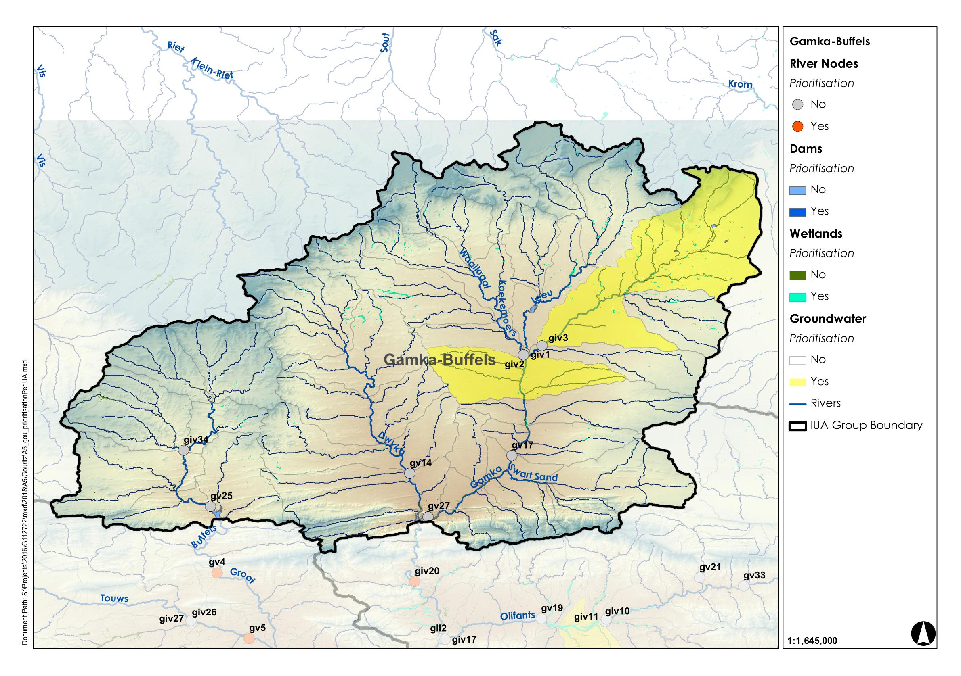
C6 Gamka-Buffels
Regulating and Supporting benefits |  |  |  |  |  |  |  | Biodiversity maintenance | Provision Benefits |  |  | Cultural Benefits
Flood attenuation | Streamflow regulation | Water Quality Enhancement
 |  | Sediment trapping | Phosphate assimilation | Nitrate assimilation | Toxicant assimilation | Erosion control | Carbon storage |  | Provision of water for human use | Provision of harvestable resources | Provision of cultivated foods | Cultural heritage | Tourism and recreation | Education
x | x | x | x | x | x | x | x | x | x | x
Wetland Region | Wetland Resource Unit | Priority |  |  | PES | EIS | REC | Quantity |  | Quality |  |  |  |  |  | Habitat |  | Indicators selected
 |  | Ecological Importance | Provision of ecosystem services
 |  |  |  |  |  |  |  | Water inputs | Water distribution & retention patterns | Nutrients | Salts | System variables | Toxics | Pathogens | Sediments | Geomorphology | Wetland vegetation
 |  |  | Supply | Demand
WR6 Great Karoo | Lower Nama Karoo Depression | x | x | x | AB | - | AB |  | x | x | x | x | x | x | x |  | x | Wetland vegetation and wetted perimeter

Slide 35
Typical threats to Priority Wetlands: DEPRESSIONS
Hillslope runoff
Diffuse flow/
accumulation
Channelled outflow/inflow
Ollis et al. 2013
Prioritisation process:
Ecological Importance
  NFEPA cluster
Supply/Demand
  Sediment retention
  Water quality amelioration
Infiltration/groundwater inflow (baseflow)

Slide 36
C6 Gamka-Buffels
IUA | Spatially targeted
C6 Gamka-Buffels | II
Linkage to Groundwater RQO (groundwater links to be maintained)
Name of Wetland Resource Unit | Component | Sub-component | RQO | Indicator/ measure | Numerical limits
Upper Nama Karoo Depression | Quantity | Water distribution & retention patterns | Seasonality to be maintained in order to protect the wetland. | Wetted perimeter | N/A
 | Habitat | Wetland vegetation. | Wetland vegetation must be maintained or where necessary improved in order to protect the wetland vegetation. | Wetland vegetation score from the vegetation module of WET-Health (Level 2). | Develop baseline of wetland vegetation. Repeat every three years and assess and report with a view to assess if there have been any changes in the state of the system.

Slide 37
F12 Duiwenhoks
IUA |  |  | NB | Supply | Demand
F12 | WR3 Southern Coastal | East Coast Shale Renosterveld Channelled Valley Bottom and Floodplain (Goukou) | x | x | x
 |  | East Coast Shale Renosterveld Channelled Valley Bottom and Floodplain (Duiwenhoks) | x | x | x

Slide 38
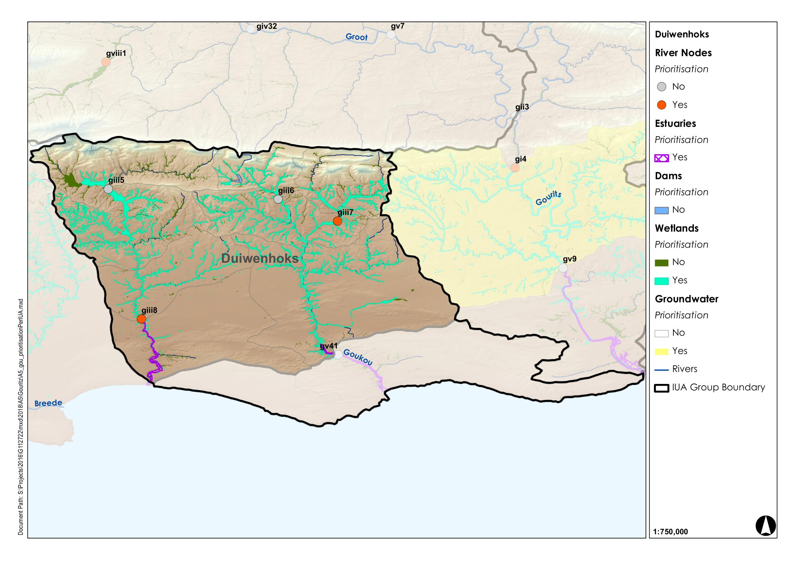
F12 Duiwenhoks
Regulating and Supporting benefits |  |  |  |  |  |  |  | Biodiversity maintenance | Provision Benefits |  |  | Cultural Benefits
Flood attenuation | Streamflow regulation | Water Quality Enhancement
 |  | Sediment trapping | Phosphate assimilation | Nitrate assimilation | Toxicant assimilation | Erosion control | Carbon storage |  | Provision of water for human use | Provision of harvestable resources | Provision of cultivated foods | Cultural heritage | Tourism and recreation | Education
x | x | x | x | x | x | x | x | x | x | x | x
x | x | x | x | x | x | x | x | x | x | x | x
Wetland Region | Wetland Resource Unit | Priority |  |  | PES | EIS | REC | Quantity |  | Quality |  |  |  |  |  | Habitat |  | Indicators selected
 |  | Ecological Importance | Provision of ecosystem services
 |  |  |  |  |  |  |  | Water inputs | Water distribution & retention patterns | Nutrients | Salts | System variables | Toxics | Pathogens | Sediments | Geomorphology | Wetland vegetation
 |  |  | Supply | Demand
WR3 Southern Coastal | East Coast Shale Renosterveld Channelled Valley Bottom and Floodplain (Goukou) | x | x | x | D | Moderate | D | x | x | x | x | x | x | x | x | x | x | Water distribution & retention patterns, Wetland vegetation and erosion monitoring
 | East Coast Shale Renosterveld Channelled Valley Bottom and Floodplain (Duiwenhoks) | x | x | X | D | Moderate | D | x | x | x | x | x | x | x | x | x | x | Water distribution & retention patterns, Wetland vegetation and erosion monitoring

Slide 39
Typical threats to Priority Wetlands: VALLEY-BOTTOM (Channelled)
Hillslope runoff
Narrower
Steeper
Ollis et al. 2013
Prioritisation process:
Critically endangered vegetation
NFEPA clusters
Upper reaches within Strategic Water Source Areas
Reserve studies: Duiwenhoks Wetland System (Gouritz)
Working for Wetlands Program: Duiwenhoks East Wetland (moderate priority); Grootbosberg Wetland; Lower Tierkloof; Upper Gaffie
The priority wetlands which were worked on by Malan et al. Goukou wetland
Greater infiltration/groundwater inflow (baseflow)

Slide 40
F12 Duiwenhoks
IUA | Spatially targeted
F12 Duiwenhoks | III
Upper reaches have management considerations
Name of Wetland Resource Unit | Component | Sub-component | RQO | Indicator/ measure | Numerical limits
East Coast Shale Renosterveld Channelled Valley Bottom and Floodplain (Goukou) | Quantity | Water distribution & retention patterns | Baseflow is required in order to maintain saturation. | Water distribution and retention patterns. | Compile an accurate desktop basemap for the system prior to the start of monitoring using the most recent satellite imagery and wetland map.
 |  |  |  |  | At the same time undertake a rapid PES assessment and take fixed point photographs of key features from closest access points.
 |  |  |  |  | Repeat every 3 years and assess and report on this with a view to assess if there have been any changes in the system.
 | Habitat | Geomorphology | The ecosystem services, in terms of sediment retention, provided by the wetland must be managed so as not to undermine the ecological value. | Wetland geomorphology score from the geomorphology module of WET-Health (Level 2). | Repeat every three years and assess and report with a view to assess if there have been any changes in the state of the system
 |  | Wetland vegetation. | Wetland vegetation (in particular peat areas) and geomorphology must be maintained or where necessary improved in order to protect the wetland vegetation. | Wetland vegetation score from the vegetation module of WET-Health (Level 2). | Repeat every three years and assess and report with a view to assess if there have been any changes in the state of the system.

